Slide 1
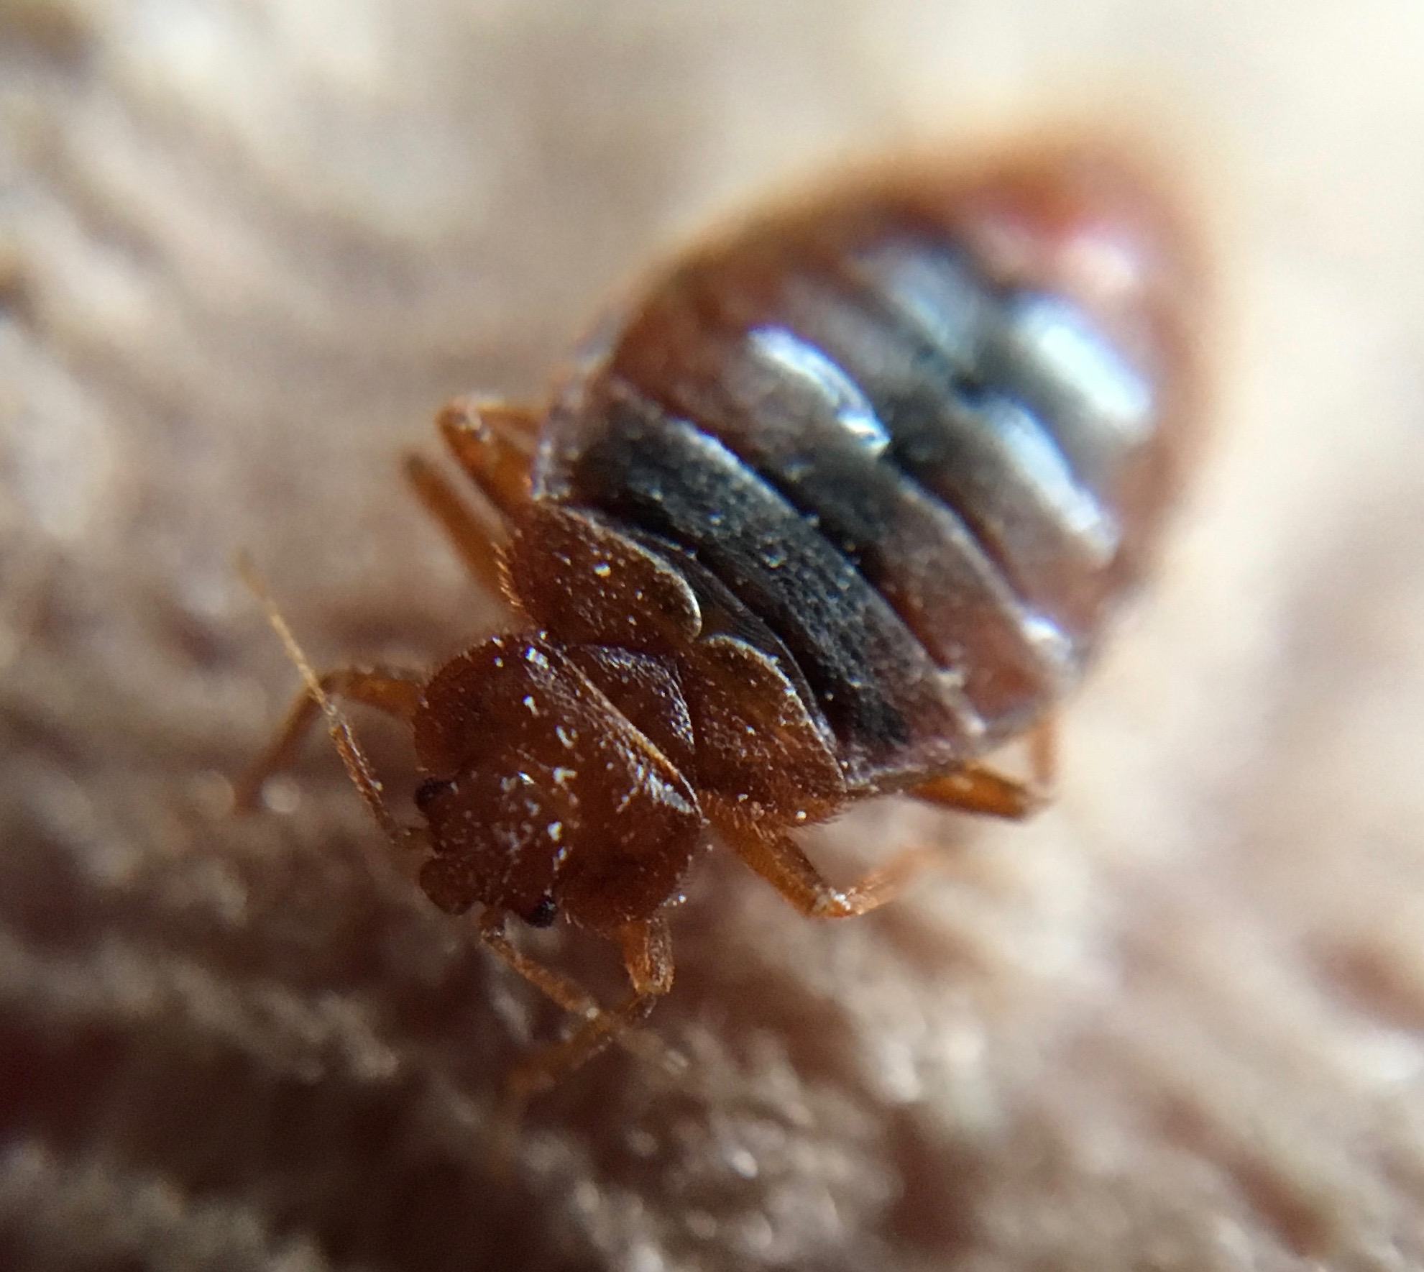



Getting Rid of Pests Safely!
Pest control in your home starts with you.
Notes:
Edit slides to include site specific information from your site. This power point covers bed bugs, rodents and cockroaches. pull the slides you need from the presentation
“Let’s get up close and personal with the pests we might find in your home.”
You might want to say something like:
“You may not be able to do all the things we talk about today but pest control still starts with you because reporting any pests or signs of pests you see is the single most important thing to do. You know your home best and you, most likely will be the first person to see a pest. When you see a pest or signs call……………….immediately”

Slide 2

Let’s go forward with a new understanding and find solutions together
Notes:
I go around making the case for pest management professionals being more like doctors than plumbers. Work together and be part of the conversation. We need to step up to the plate and be interested in all of the solutions to our pest management problems. Let’s not look to the past failures or play the blame game, but go forward working together to find solutions.

Slide 3
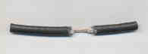
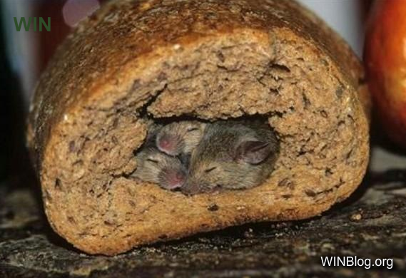
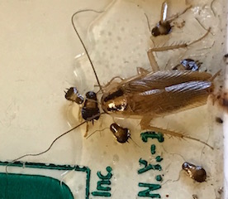
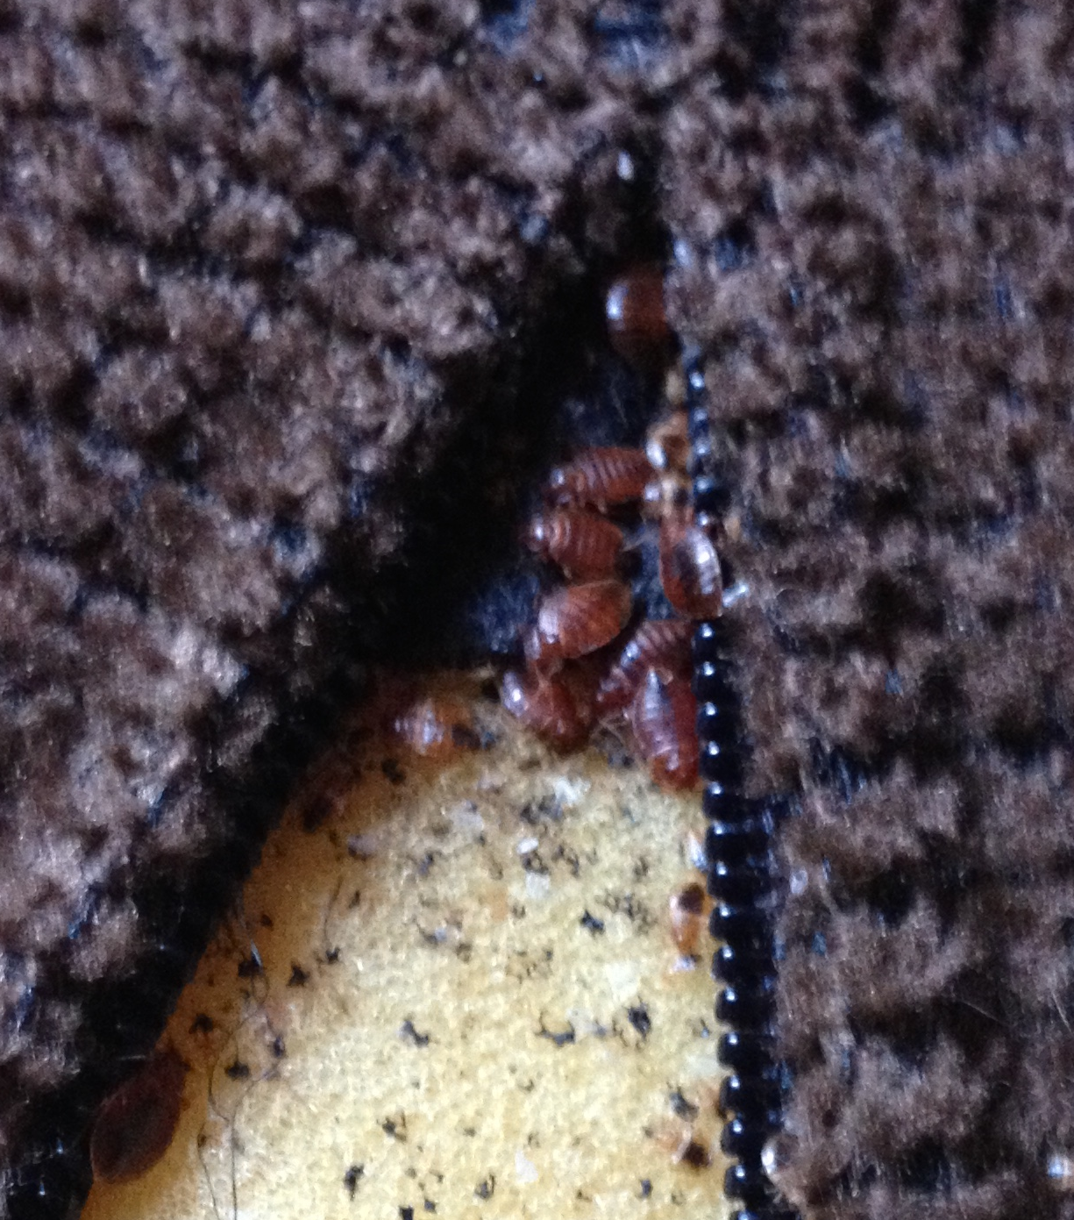
What’s a Pest?
“Any destructive or troublesome organism”
Something we don’t like, where we don’t want it!
Rodent-chewed wire – fire hazard!
Mice nesting – wherever!

Slide 4
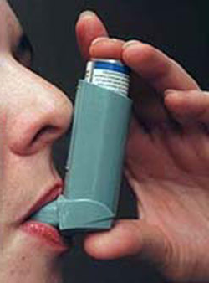
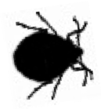
What do pests do to us?
Pests cause allergies & can trigger asthma
Asthma: rate has doubled in 20 years
Bites can transmit Lyme, West Nile, Zika, rabies
Carry disease pathogens and contaminate food
  Rodents carry, Leptospirosis, Plague, Salmonella, Typhus
Notes:
Cockroaches and mice cause asthma and carry diseases and germs

Slide 5
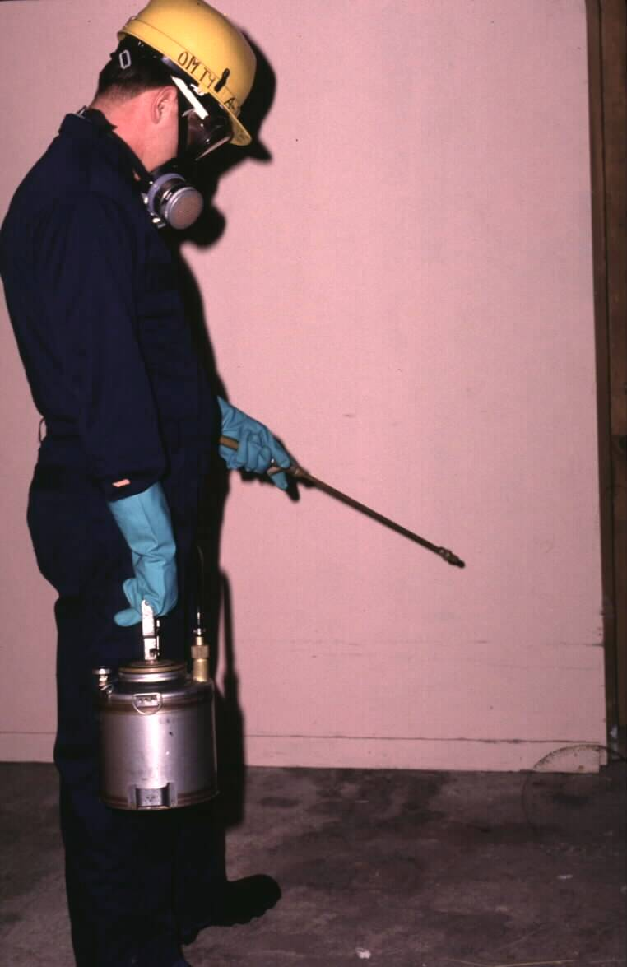

How have we dealt with pests?
Children and seniors are more susceptible to pesticides and deserve special protection.
Routine spraying of pesticides
is not an effective or safe option
Notes:
5
Refer back to the discussion at the beginning of the day about previous practices and their effectiveness.
Avoid disparaging pesticides. Put them in context. Pest management using only routine spraying of pesticides is akin to farming cockroaches. The building supplies food, water, and shelter for cockroaches to thrive in, and once a month some are harvested (killed by pesticides). As long as food, water, and shelter are present, the cockroaches will be there too. Pesticides work to kill most of the time, but they do not solve the ongoing problem and may pose unnecessary risk.

Slide 6
Pesticide risk by application method
Less risk of exposure
More risk of exposure
Tamper- resistant station
Gel bait
in a crevice
Total release fogger
Notes:
Risk of exposure is the risk of coming in contact with a pesticide. Note that touching a pesticide that can be seen is not the only way to be exposed to pesticides. Get trainees to think about pesticides getting into the air and remaining on surfaces even when they can’t be seen or smelled.
Another risk to consider is that someone could misuse a pesticide by applying it incorrectly.
Suggestion: Have trainees think of and place on the gradient one or two other application methods they have seen.

Slide 7

What all pests need
Food
Water
Shelter
Food
Water
Shelter
Notes:
7
Pests require three things to survive: food, water and shelter. Without any of the three, they won’t “stand up.” The three legged stool illustrates this point.

Slide 8
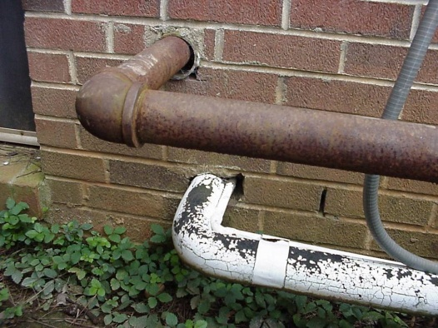
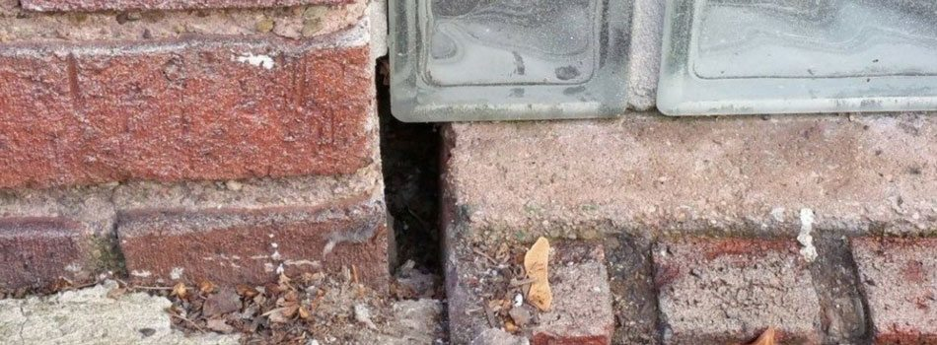
How do they get in?
Boxes and belongings
Find out!
  Look outside your home, around windows
  Where have you seen them? Mice rarely travel more than 10 feet from their nest for food
  REPORT HOLES TO MANAGEMENT

Slide 9
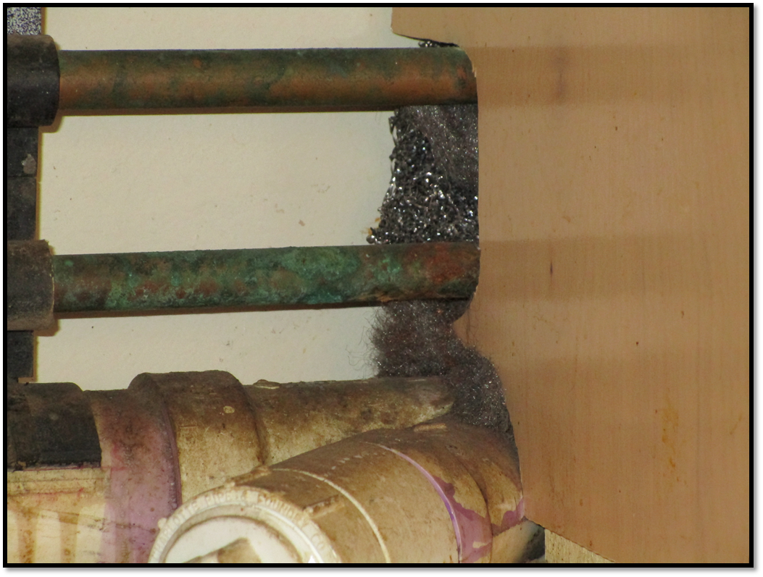
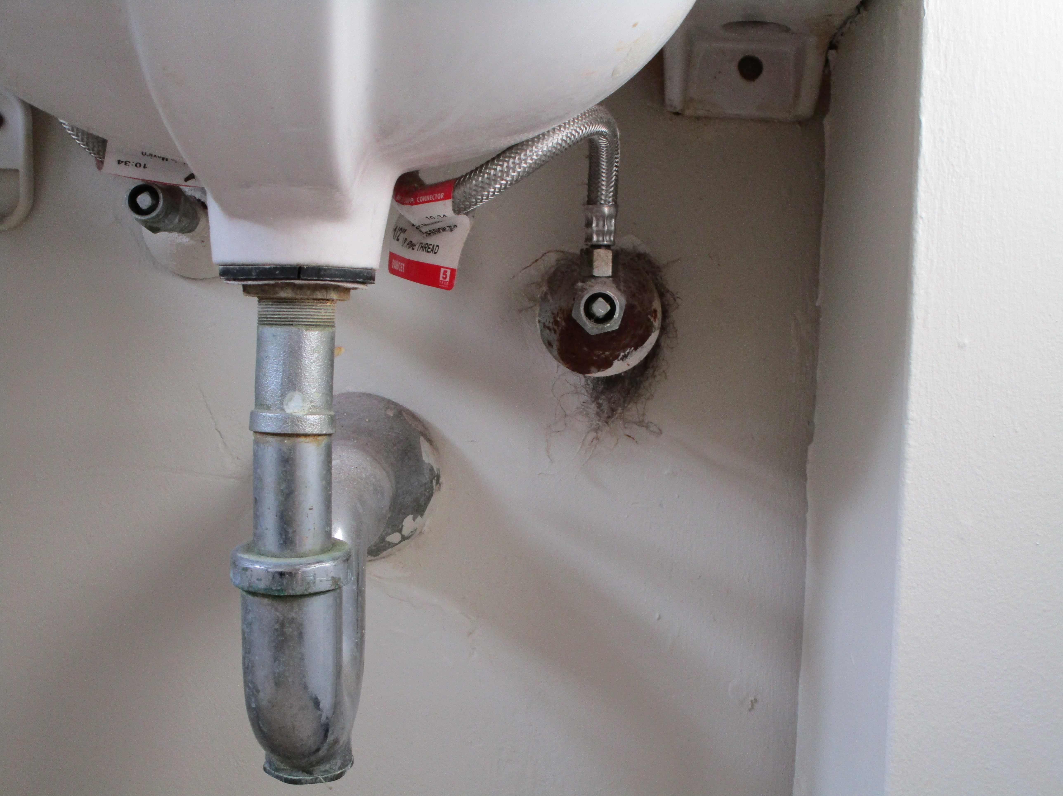
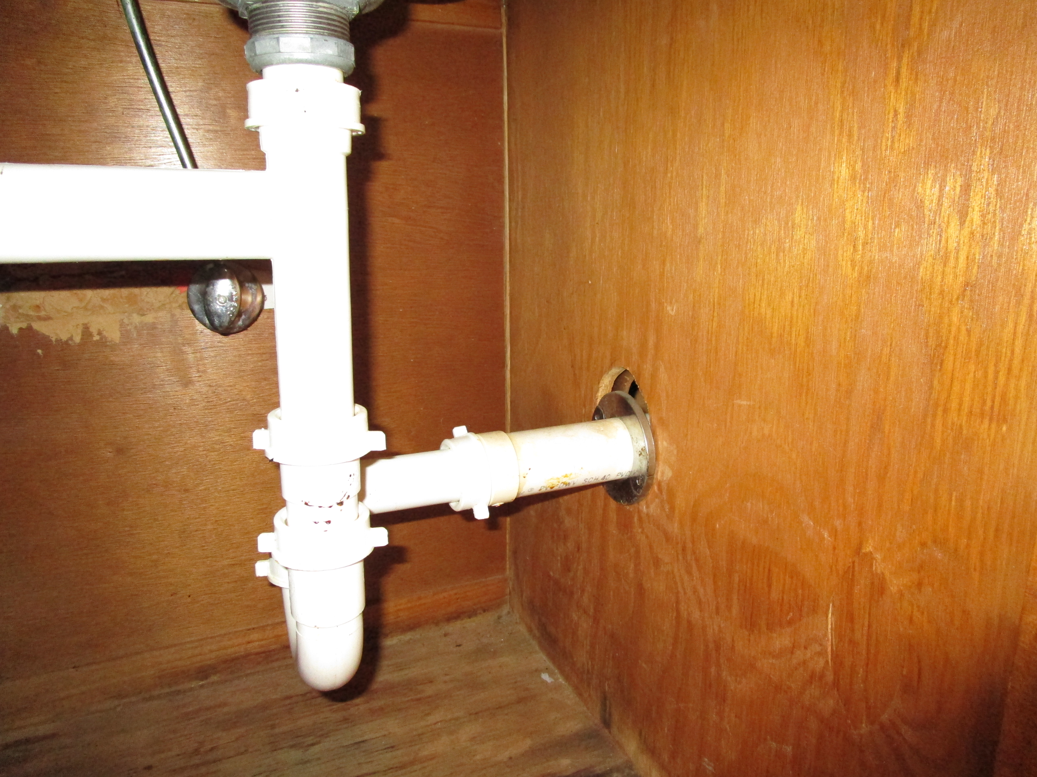

Slide 10
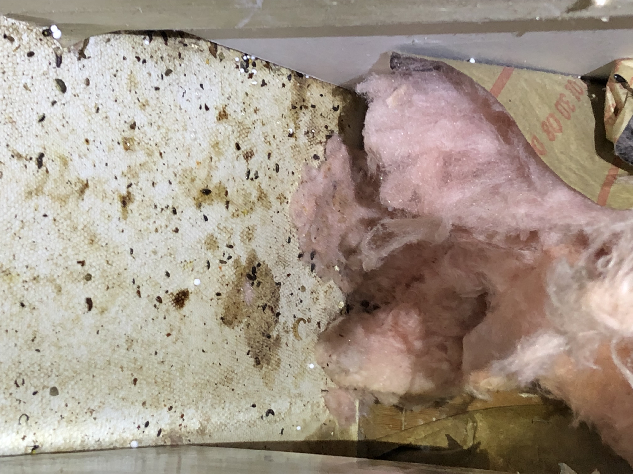
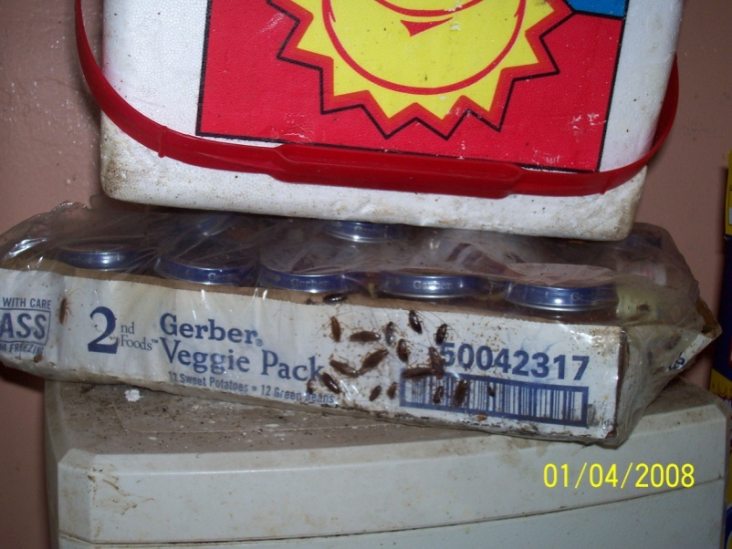
Where do they hide?
Look near sources of food and cardboard boxes
Look for droppings and nests

Slide 11
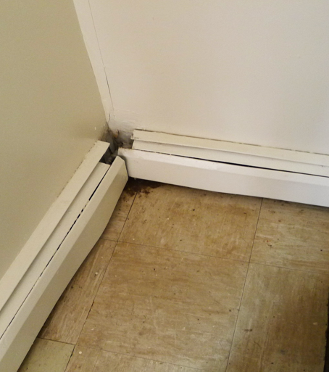
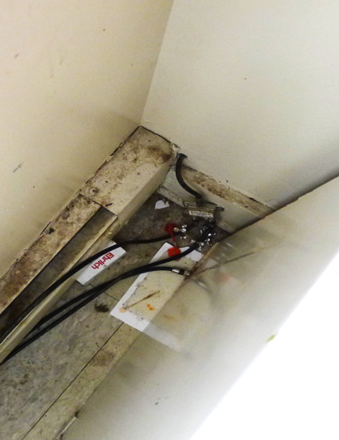

Look near sources of heat
Notes:
Abundant mouse body smears indicating the very heavy traffic pattern from nest below the floor (where the radiator line penetrates and connects to the heater). The urine contains the asthma-causing mouse urine proteins (MUPs), which are volatilized by the heat into the living quarters of the apartment.
A corner area nearby an appliance. This scenario is common within many mouse infestations in apartment buildings. The yellow arrow points to the mouse body grease (sebum) and urine that collects after mice have traveled hundreds of times over the same surface. More urine with asthma-causing mouse urine proteins (MUPs). Note the attempt at “control” via laying down a sticky trap in the area just to the right of the yellow arrow on the floor.

Slide 12
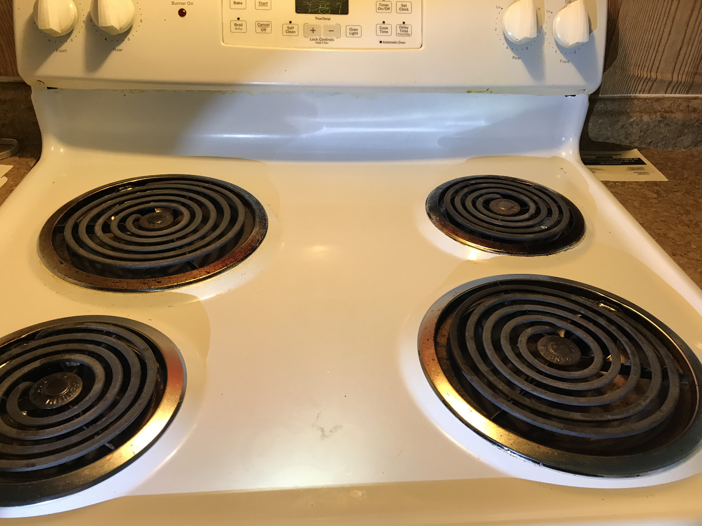
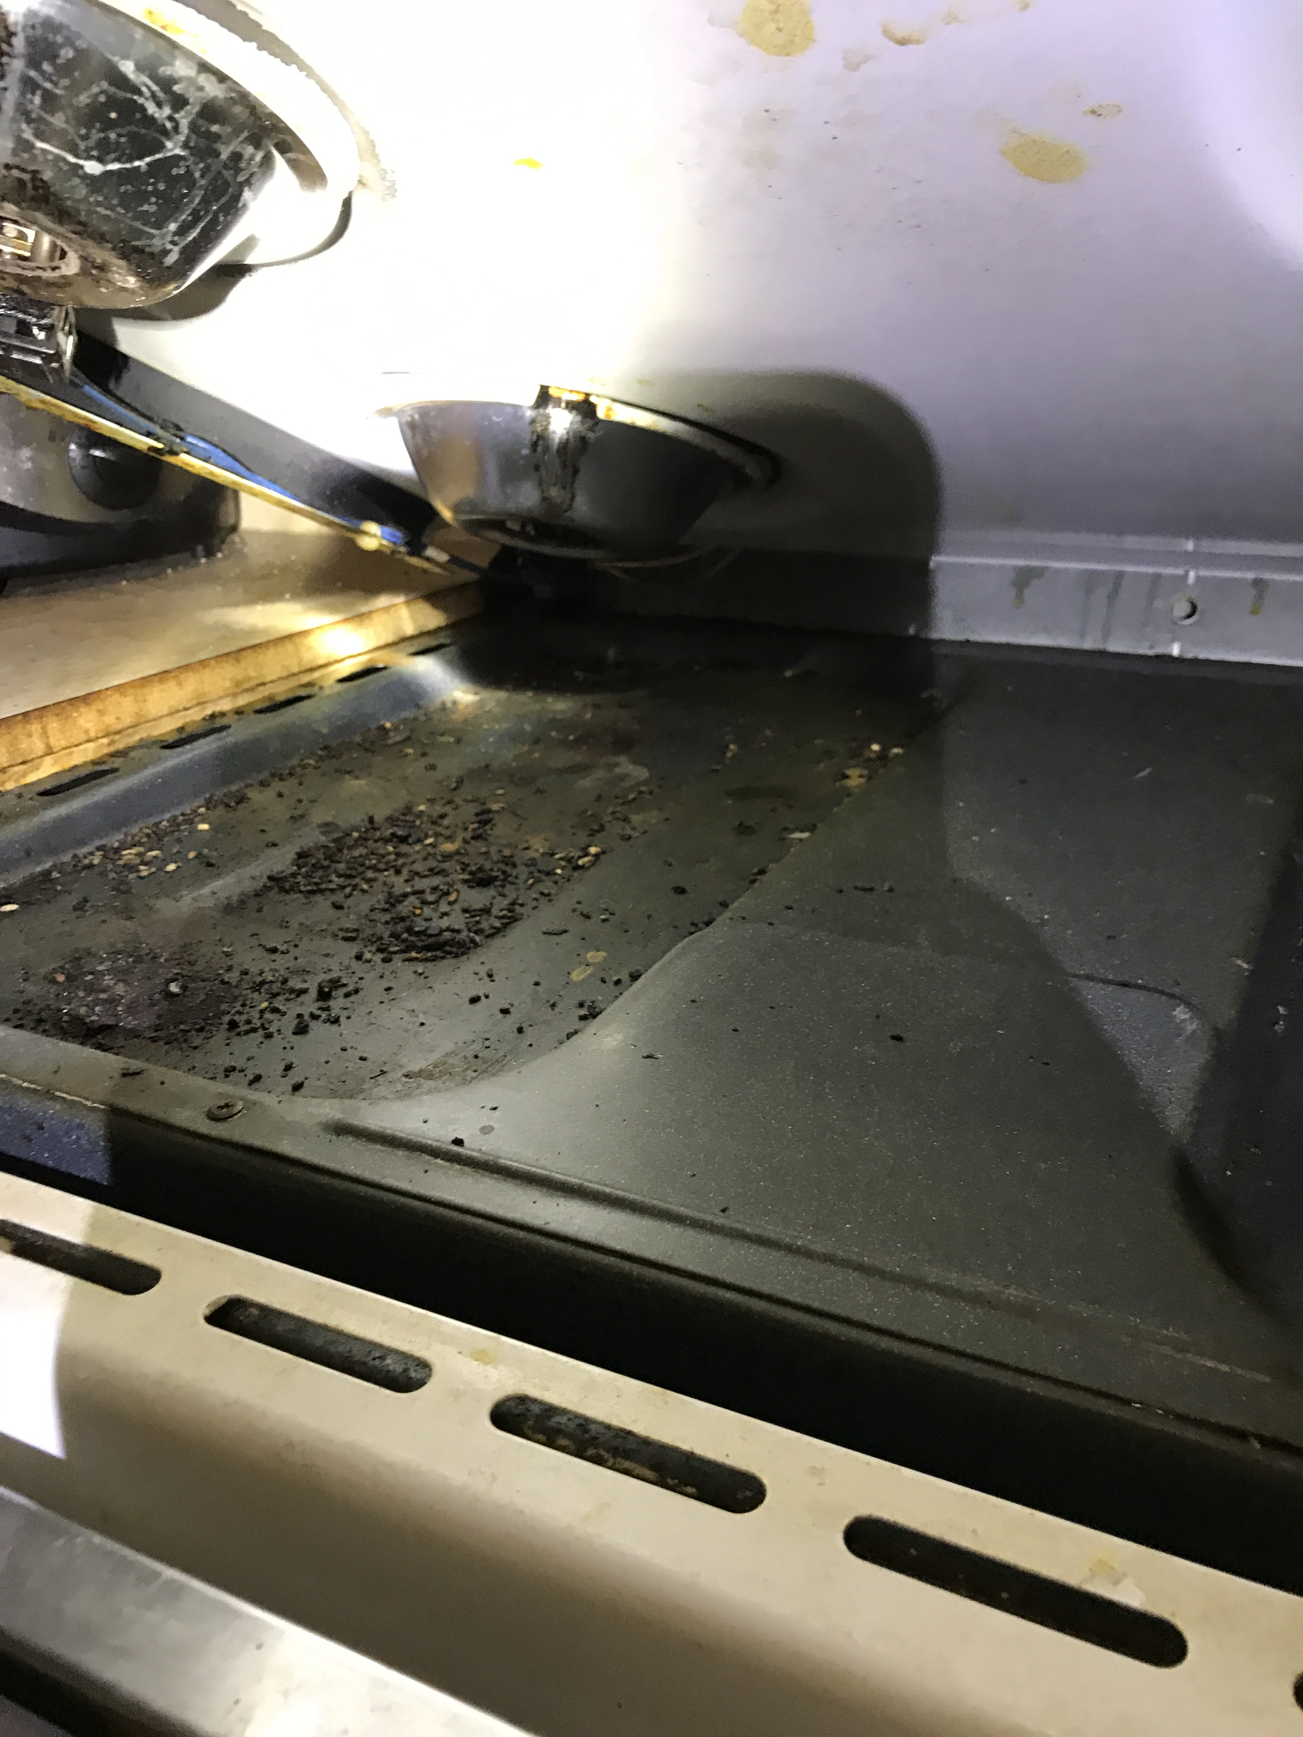
Inside the stove!

Slide 13
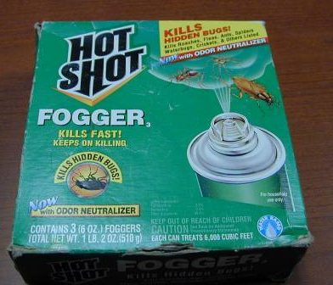
Find anything? Report to management
[add phone # or site specific information here]
Notes:
It’s easy to pick up a can of pesticide but the over the counter products don’t work and worse just push the bugs further into hiding making them harder to reach by a professional. Repot pests, don’t self-treat. Pictured here, mystery white powder right next to a child’s snacks, pesticide rack next to barbies, no foggers!

Slide 14
Pests you might find:
German Cockroaches, Public Enemy #1
Notes:
Four types of cockroaches found in public housing are of concern. German Cockroaches have the highest priority. Other kinds of cockroaches exist, but are not covered here because they are not found in large numbers in buildings. These non-pest kinds usually are carried into buildings by accident.
Different kinds of cockroaches have different preferences for food and shelter. American cockroaches like hot environments; Oriental cockroaches like cool environments. Brownbanded cockroaches like to be “high and dry.”
American and Oriental cockroaches are invaders. They typically enter the home seeking food or water but do not remain in large numbers.
German (especially) and Brownbanded cockroaches are infesters. They take up residence in the home when adequate food, water, and harborage are found and their populations may grow exponentially.
Trainees should be able to identify American, Oriental, and German cockroaches.

Slide 15
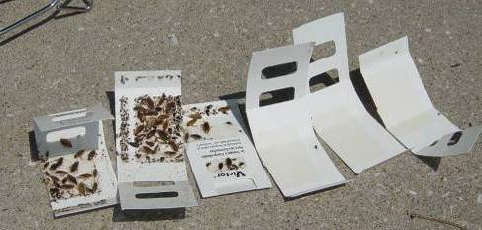
Monitors help find cockroaches
Notes:
Tell residents if they see monitors to leave them in place, check once in a while, and report if they see cockroaches

Slide 16
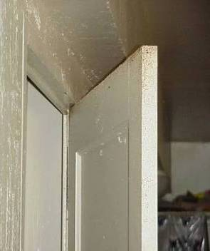
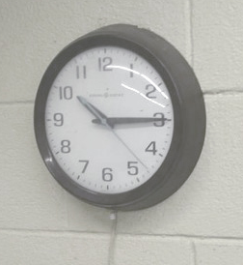
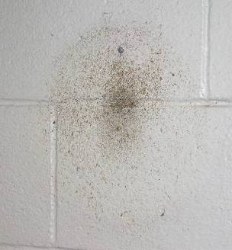
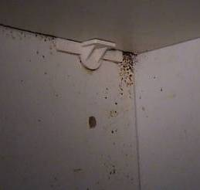
Frass (poop) tells us if we have cockroaches
Door
Wall clock
Under a cabinet
shelf
Behind the wall clock
Notes:
Frass along the top of a door, under a shelf, and on a wall where a clock was hung (note that when the clock was there the place looked clean…trainees have to know where to look to find signs).
Suggestion: use the clock as a review of the kinds of cockroaches. The kind that infested behind the clock were Brown Banded (high and dry).

Slide 17
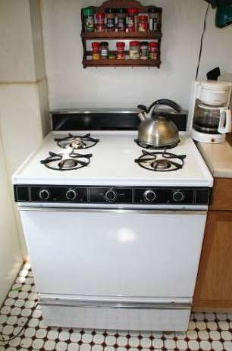
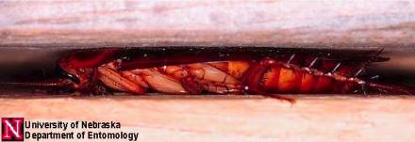

Where cockroaches live
Prefer kitchens and bathrooms near food and warmth
In cracks and crevices where their bodies touch surfaces above and below
Notes:
17
Trainees have to know where to look for cockroaches because they are most active at night and most will be hiding at any time. Cockroaches love appliances that have water associated with them.
Suggestion: Have trainees reason that the kitchen is the most likely place (food and warmth from the stove, refrigerator, and under the sink); the bathroom is second because of water. Cockroaches can be found in other rooms as well. Inspection should be done in all rooms (even bedrooms, living rooms), especially when the infestation is bad. If cockroach signs are found in the unit, bait should be placed in all rooms. Take this opportunity to get the trainees to think like a pest and decide where they would want to live.

Slide 18
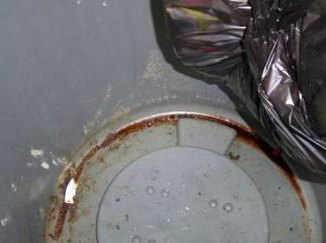
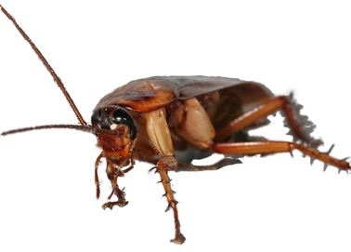
What cockroaches eat
Crumbs
Grease
Trash
Cardboard glue
Just about anything
YUM!
Under the bag in a trash can
Notes:
18
Cockroaches will survive on most anything.
One drop of grease will feed 20 cockroaches for a day…cleaning is important in cockroach control!

Slide 19
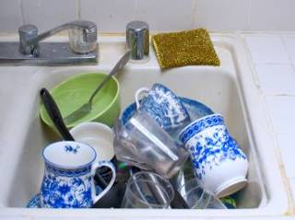
Prevention
What’s the problem here?
How would you fix it?
Notes:
19
Observations: Dog food and water left out. Dirty dishes are left in the sink to soak overnight.
Trainees should now apply what they’ve learned.
Trainees should suggest that cleaning and drying dishes nightly and picking up pet food at night will go a long way to control the pest at no cost to the property.
This example shows how knowledge of the pest along with awareness of the environment and a simple change in practices can result in pest management.
Suggestion: Discuss the use of a pan under pet food and water dishes. This makes it easier to pick up spills from a sloppy eater and may restrict some pests from feeding.

Slide 20
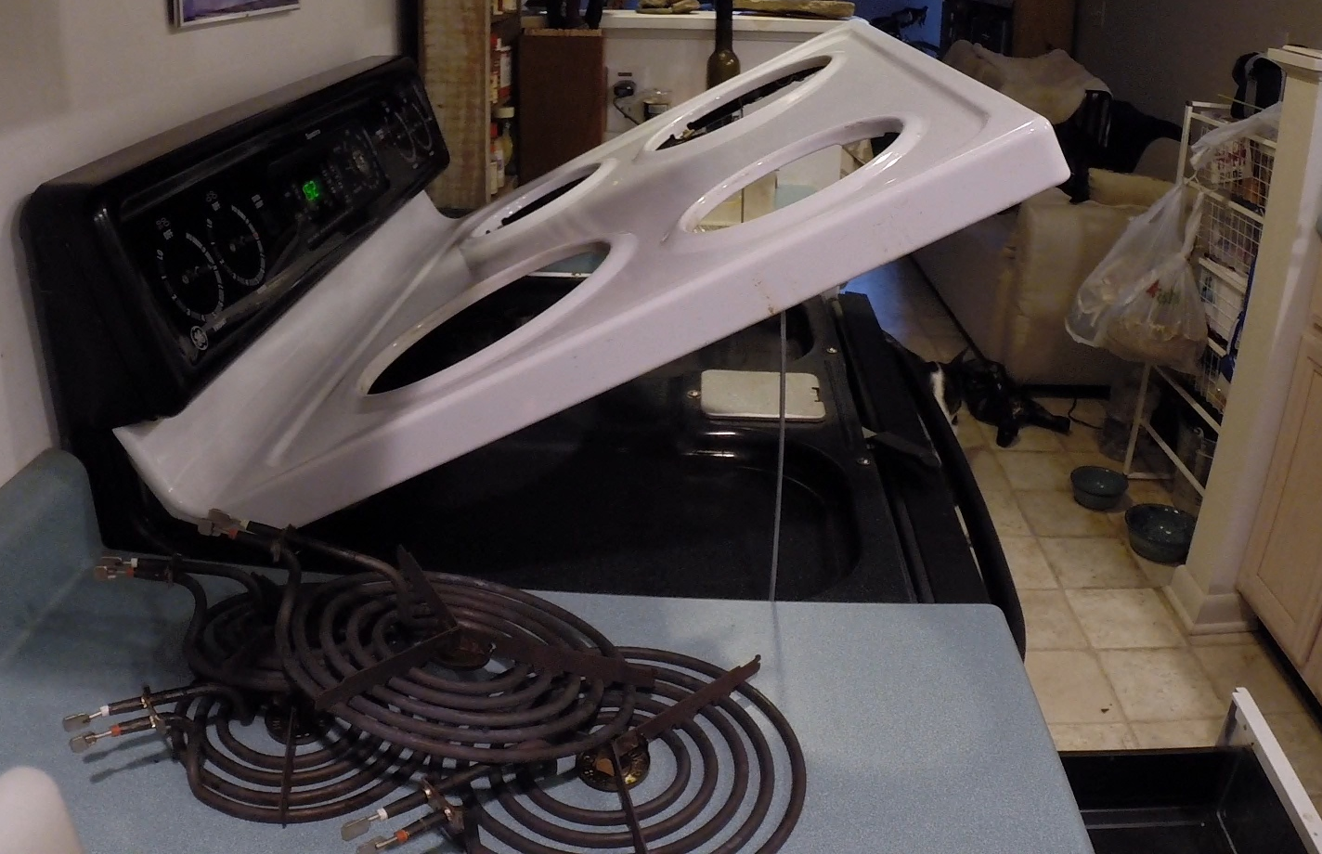
Prevention
Does your stove come apart for cleaning?
Notes:
Ask attendees to raise their hand if they have taught this skill to a resident, family member, or friend.

Slide 21
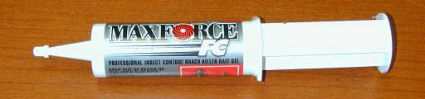
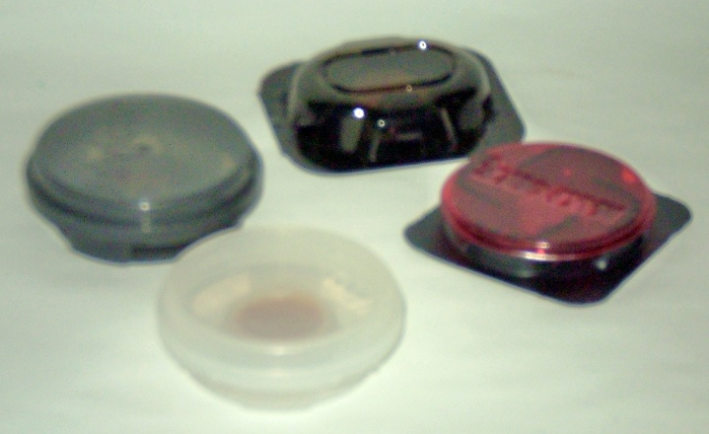
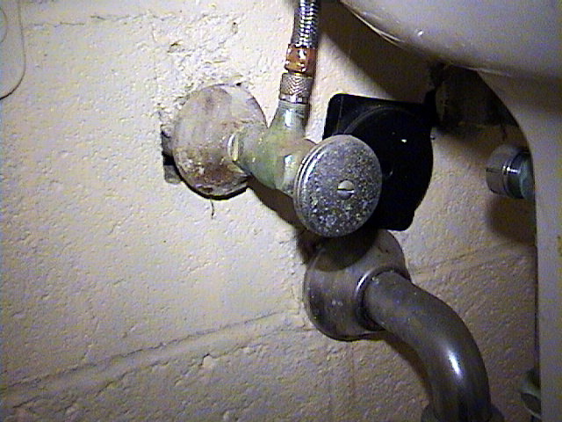
Best ways to control Cockroaches
Clean up food and clutter (no hiding spots)
BAITS – you use pucks, professional uses tubes
Professionals use tubes
Pucks you can buy and
place under sink

Slide 22
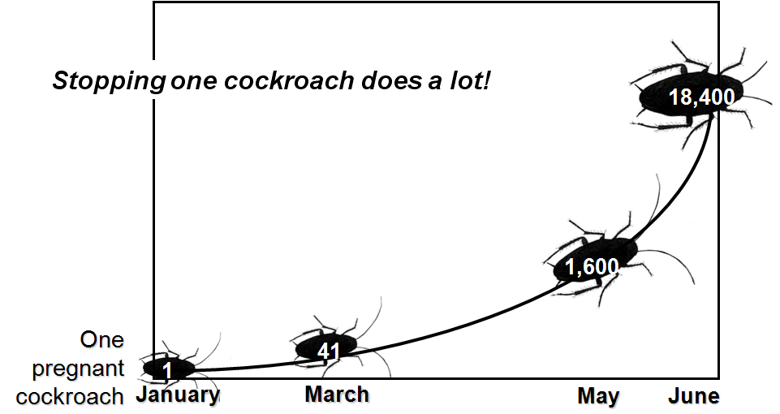
One German cockroach,
1/2 a year…
Notes:
This growth curve is for a German cockroach. A population can get out of hand very quickly. Calculations are based on 40 eggs per case (20 male, 20 female), one month for eggs to develop, one month after hatching they can reproduce. Females develop one egg case a month. The graph assumes no death due to environmental factors and a 1:1 male to female ratio which are unrealistic, but the potential for population growth is a fact, with or without environmental influences.
Use this graph and the asthma connection to make the argument that no number of cockroaches should be tolerated. One can become a lot very quickly. The best way to stop an infestation early is to have sticky trap monitors placed under the sink, behind the refrigerator, and in the bathroom. Monitors can alert you to a new (e.g., from a store or neighbor), or a growing infestation before cockroaches or their frass is seen.
22

Slide 23
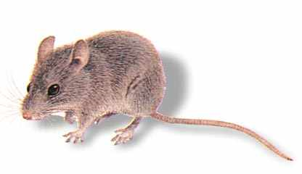
Mice

Slide 24
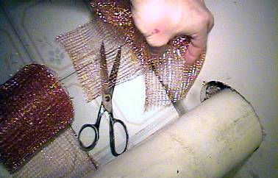
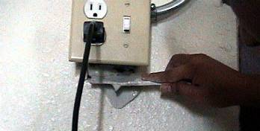
How do you get rid of mice?
Get rid of all food & water
  Keep garbage cans covered
Seal or report openings bigger than a pencil width!
Maintenance should:
  Holes should be stuffed with copper mesh
  Use silicone caulk, spray foam, spackle or cement
  Sheet metal or screen for outside
Use snap traps
Don’t use poison in your home!

Slide 25
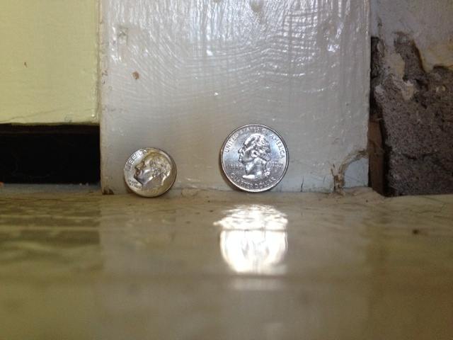
How do they get in?
A mouse can fit through a hole the size of a dime and rat can fit through a hole the size of a quarter. Seal up those spaces

Slide 26
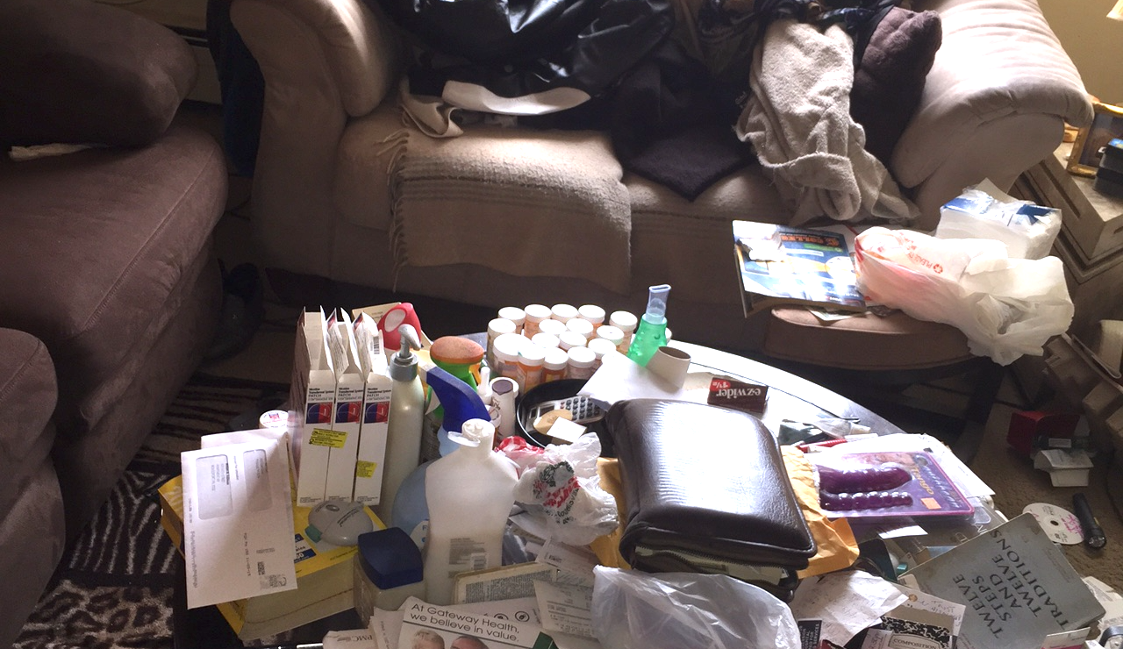
Where do they live?
Clutter = hiding spaces
Notes:
Get rid of clutter, it creates hiding spaces for pests

Slide 27
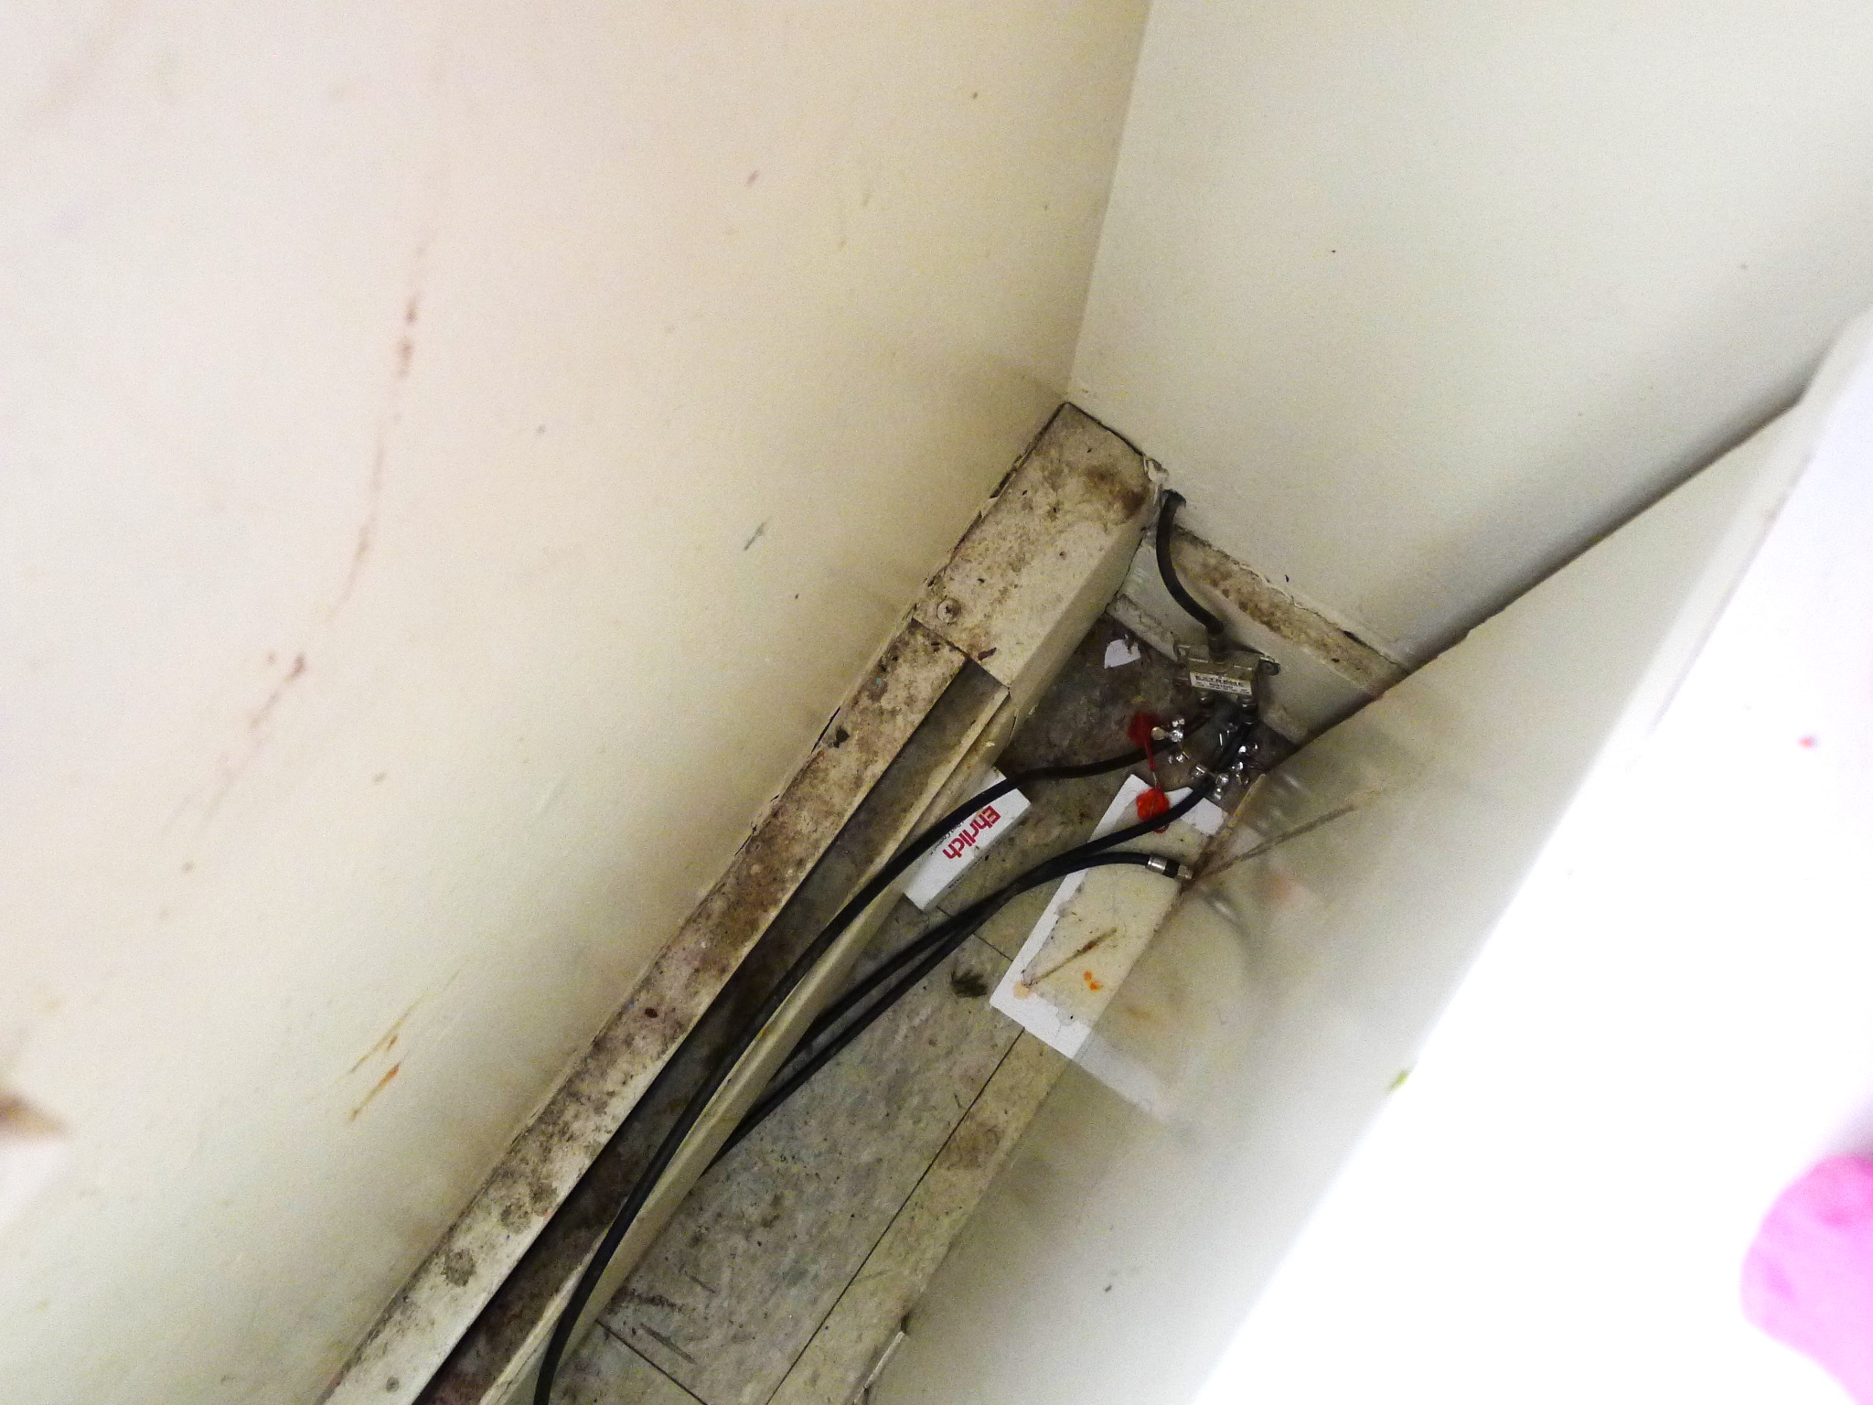
Where do they live?
Look for signs (mouse trails) and report so a professional can treat

Slide 28
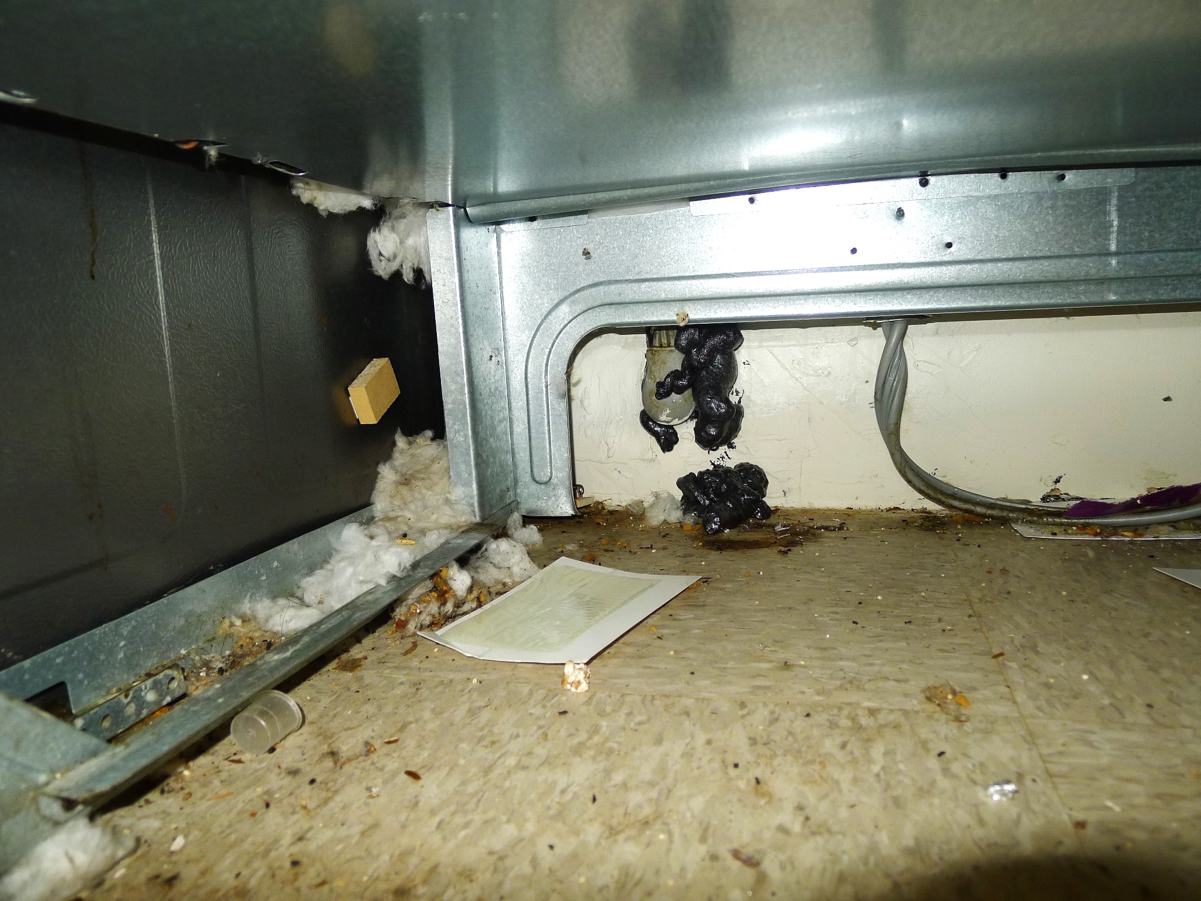
Where do they live?
Check under the stove!

Slide 29
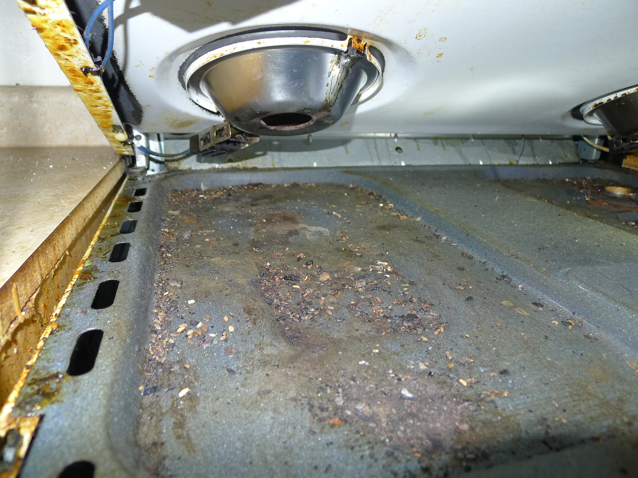
Where do they live?
Can you open the top of your stove?

Slide 30
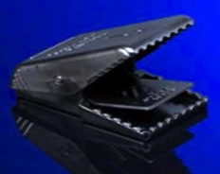
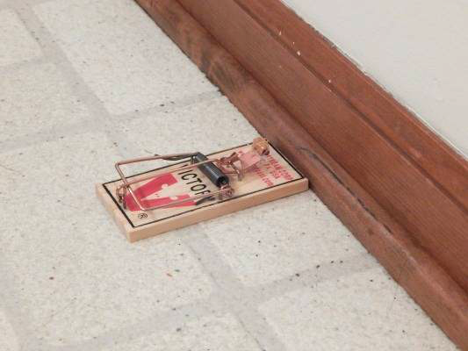
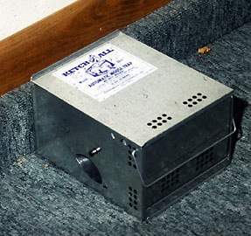
How should we get rid of them?
TRAPS
Effective and reusable
More ARE better
Check often
Placement is key
Notes:
30
Traps come in several forms, demonstrate traps and pass them around.
Snap traps. Cheap, easy, and effective. The newer style is much easier to set, clean, and empty the rodent. These traps work like binder clips.
Glue traps. Cheap and easy, but the rodent takes a long time to die and makes noises that can be disturbing to residents. Adult mice and rats will usually avoid glue traps. They can be made more effective by using box-style traps or putting the glue board inside short sections of PVC pipe; mice prefer tunnels and dark areas, and will not detect the glue boards until they cannot get away.
Curiosity traps. Can be very effective. They come in many styles, but you must check them often and may be left with a live animal that needs to die.
Electronic traps. Expensive. Electrocutes a mouse with a small electrical charge. One can dump out the mouse without touching it.
Live traps are available but not recommended. What does one do with the mouse once it is caught? Or an angry rat?
Ultrasonic devices. Have not been shown to be effective.
Baits could be: fabric, dental floss, food…rodent populations will have preferences for the food that is normally available to them (e.g. rats next to a restaurant that throws away a lot of chicken will prefer chicken).
Reference: Preventing Rats on Your Property, pp 11–12.

Slide 31
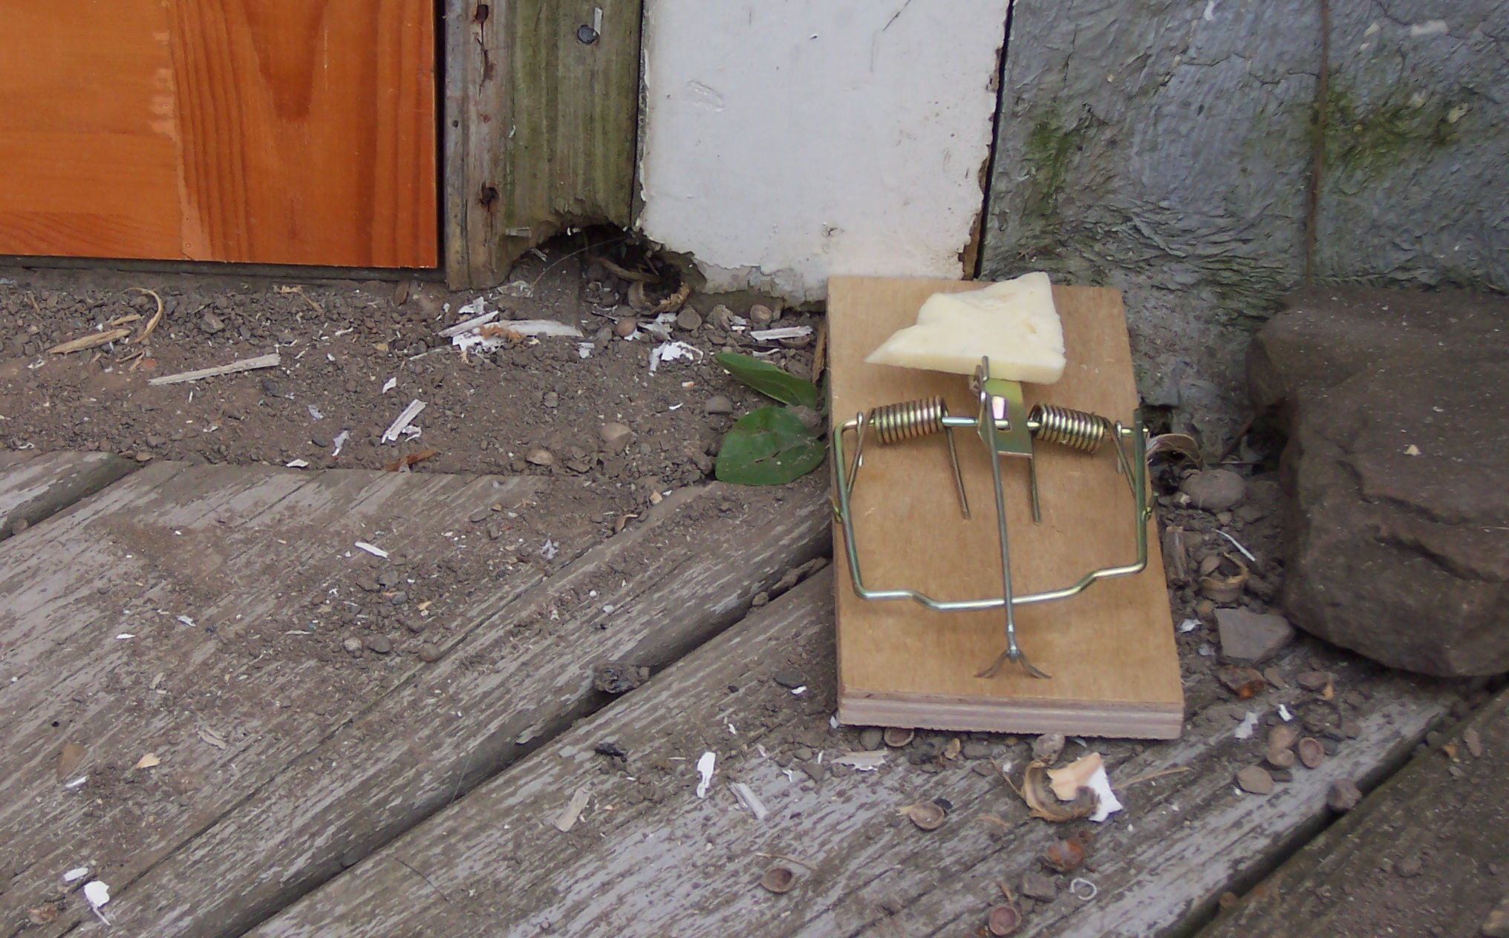
Trap placement is key
Place the trap against the wall where rodents travel. (The bait side of the trap should touch the wall.)
Notes:
Always place snap traps against walls, ideally in corners, or in known runways. Traps may be doubled up, and the more traps used the more effective they will be.
The reason for this placement is twofold:
Rodents are likely to travel the same paths along walls every night. Setting traps where they already travel increases the chance of one running over the trap.
Rodents get a lot of information from their hairs and have a very fast response time. If a trap is along a wall, the wall blocks them from reacting to the trap closing by running out to the side.

Slide 32
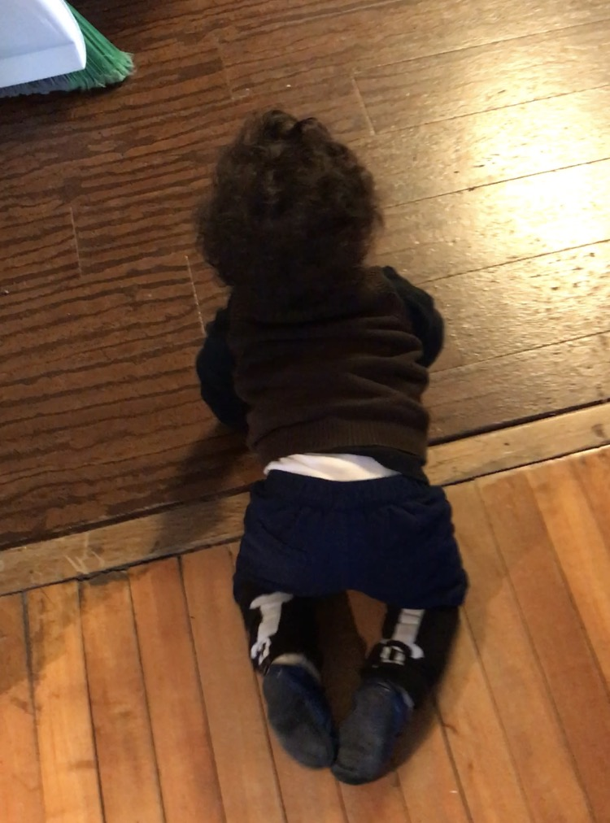
Cleaning mouse droppings will
Remove allergens and irritants that can cause or trigger asthma
Kill germs and contaminants that cause illness

Slide 33
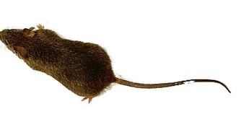
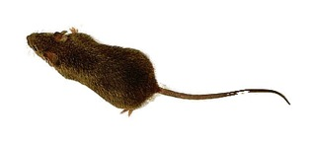


One mouse, one year…
Stopping one mouse does a lot!
4,500
One pregnant mouse
650
40
1
January
May
September
December
Notes:
Mice can mate when they are one month old. The gestation period is 19 days. There are 4–7 young per litter, eight litters per year, 30–35 young weaned per female per year….This growth rate is the same as that of cockroaches!
This graph assumes six litters of six per year, 50% female in each litter, and all survive. This is not realistic (all will never survive), but it is a vivid picture that one mouse will build a large family very quickly.

Slide 34
Bed Bugs

Slide 35
Myth or Truth?
Bed bugs carry disease
I need to throw out my mattress if I see bed bugs
Putting my mattress in cold or sun will kill bed bugs
Bed bugs are too small to see
Bed bugs eat left over food
Bed bugs can fly
Boric acid kills bed bugs
Turning up my thermostat to super heat my apartment will kill bed bugs
I can handle bed bugs on my own, and buy pesticides or use products that work
Notes:
This slide is hidden because you may not want to perpetuate any myths by saying them aloud. Know your audience and if this slide is appropriate or not.

Slide 36

Bed bug control is tricky…
Food
Water
Shelter
Can we eliminate
these for bed bugs?
Food
Water
Shelter
Notes:
36
Pests require three things to survive: food, water and shelter. Without any of the three, they won’t “stand up.” The three legged stool illustrates this point. But with bed bugs we can’t eliminate their food water and shelter, it’s us and our homes

Slide 37


What do bed bugs look like?
Bed bug life cycle
Fed
Not recently fed
Notes:
Bed bugs can be two different shapes, depending on when they last fed. They expand when full of blood and quickly (within a few hours) digest the blood and poop out the excess so that they are flat again. A recently fed bed bug will be plump, but after it digests it is back to being flat.
Like cockroaches, baby bed bugs look like the adults, only smaller.

Slide 38

The feeding process
Start 3 min 9 min 12 min
Photo: Whitney Cranshaw
Notes:
Mike Merchant’s slide
Note that during feeding the adult bed bug’s body becomes distended with blood. This is normal. Not all bed bugs will look exactly alike.

Slide 39





Know the signs
Bites
Fecal spots
Shed skins
Dead bed bugs
Live bed bugs
Photo: Susannah Reese
Photo: Susannah Reese
Photo: Susannah Reese
Photo: Alex Yelich
Notes:
39
Bed bugs are small and very good at hiding, so a flashlight is needed to see them (or evidence of them).
Keep looking until either a live bed bug is found or all involved feel satisfied that there are no bed bugs.
If bed bugs are found, a few should be put on tape or in a re-sealable plastic bag for identification.
The photo shows bed bugs that were snuggled next to the screw-in foot of a recliner. It took flipping the recliner over to find them. When the foot was unscrewed, more were found.

Slide 40



Slide 41

People and bed bug bites
Prefer feeding during darkness
Bites often painless
Many people don’t exhibit an obvious reaction to bed bug bites and may not know they have an infestation
They do not spread disease
Photo: Susannah Reese
Notes:
Mike Merchant’s slide add changlu’s stats on
The one in 20 stat comes from a study done by Ron Harrison at the Orkin National office. He enlisted hundreds of volunteer Orkin employees over several years to be bitten by a bed bug. Only about 5% complained of any skin reaction to a single bite.
Will feed in daytime if necessary
May travel 20 feet from hiding place to feed…even farther if necessary
Seem to prefer humans over pets
Attracted to humans by body odor, body heat, carbon dioxide

Slide 42


How do bed bugs spread?
Actively crawl along wires, pipes, and under doors
Passively on anything coming from an infested unit (furniture, backpacks, laundry…)
What’s on the other side of the wall?
Notes:
42
Prevention is key.
Since bed bugs are so reliant on humans, they have become very good at staying close to them. In public housing, one infestation can quickly spread throughout the development. The spread usually occurs when:
-residents in adjacent units do not inspect regularly, Bed bugs will travel along pipes or on wires if their food source is removed, or if the infestation gets too crowded. If a unit has bed bugs, all adjacent units should be inspected.
-management does not have the PMP inspect and possibly treat adjacent units,
-infested items are moved through the building without being wrapped in plastic,
-infested items intended for the trash are picked up and brought home,
-staff visits multiple units per day with bags or equipment
-residents visit each other carrying backpacks,
-or bed bugs are brought to the laundry room on bedding and people bring them home from this location.
If infested items are to be brought to the trash: 1. Cover the infested item with plastic for transport through the building. 2. Once outside, make the item unusable by breaking or cutting it open. 3. Put the broken item inside a covered trash receptacle. All these steps help ensure that bed bugs are not spread into uninfested areas within the PHA.

Slide 43

I know you just want to kill them…but before you pick up that can of spray, let’s talk prevention
Notes:
and the people living with the pests, and managing facilities are inundated with adverts and messages about how to kill them. But unfortunately they don’t always get the best advice.

Slide 44

Do you inspect your bed?

Slide 45


Inspect regularly with a flashlight and lint roller
Inspect yourself – shoes, laces, socks, arms of jackets most common spots

Slide 46




Inspect where bed bugs live
Only inside homes and buildings
In any crack or crevice where a credit card edge could fit
On any item near where people rest
Photo: S. Reese
Couch cushion zippers
Photo: Dr Dawn Gouge
Mattress piping
Stuffed animals
Switch plates
Notes:
Sanitation plays a role in bed bug control because a cluttered apartment will be nearly impossible to treat. Bed bugs can hide anywhere, and cleaning will unearth them. Vacuuming and washing bed linens often will help keep populations from growing.

Slide 47

You can and should request a professional inspection

Slide 48



Install bed bug monitors
Interceptors can detect up to 95% of infestations
Trap and kill bed bugs
Determine how bad the infestation is
Two types
  Passive
  Active
Notes:
Add citation
Edited 8/1/17 removed active monitor and replaced w volcano. Also added DIY
Monitors will not control a bed bug infestation, but they will trap and kill some. More importantly, they help find bed bugs or confirm their presence so that management can take further action. There are two types of monitors for bed bugs: passive monitors do not have an attractant and must be placed where the bugs will walk over them; active monitors have an attractant —a combination of heat, carbon dioxide, and an attractive chemical.
Often bed bugs avoid sticky surfaces so sticy trap monitors are not recommended.
Reference: Rutgers University evaluation of monitoring devices: http://www.rci.rutgers.edu/~insects/bedbuginterceptor.pdf

Slide 49


Monitors

Slide 50

If you find a bed bug
Document all observations
Rapid response plan:
  Save the insect in a piece of tape or sealed container
  Report the problem to management
  Don't apply pesticides or move things around
  Prevent carrying the bed bugs to other places
  Have professional inspect the unit
Notes:
Refer back to previous discussions of the IPM log.
Collect a specimen on a piece of tape or in a jar with a splash of isopropyl (rubbing) alcohol in it.

Slide 51

Don’t give bugs a place to hide under the bed
Good Too much stuff and hiding spots

Slide 52

Do Not Throw Furniture Away!!!!
Furniture can and should be treated (heat, encasements)
Bed bugs have no problem with metal bed frames
Have maintenance throw out furniture if necessary

Slide 53

Mattress encasements
Cover mattresses and box springs
Ensure a snug fit, zip, seal,
and check for rips
Leave it on for a full year!
Cover any sharp points on the bed frame with tape or felt
Mattresses and furniture
don’t have to be thrown out if they can be encased!
Notes:
53
Use fabric encasements designed for bed bugs. The encasement drastically simplifies inspection, making early detection easier especially on the box spring which has lots of spots where bed bugs can hide. The most common site of escape is through the zipper and bed bug encasements have special zippers. Most bed bugs will die within 5 months, but leave the encasement on and sealed just in case.

Slide 54


Don’t bring them home!
Inspect yourself – cuffs & shoes when you visit infested home
Vacuum regularly
Keep your home free of clutter
Keep clean or possible infested stuff isolated in a tote
Remove clothing over plastic sheet or in bathtub and immediately launder
Just the dryer works.

Slide 55

The clothes dryer
Heat on High for 30 minutes.
Don’t over stuff
Even items that are “dry-clean only” can be put in the dryer
Dryer alone works. Not necessary to wash first

Slide 56

Know the treatment options
Vacuuming
Isolation
  Encasements
  Clear bags
  Closed plastic containers
  Make the bed an island
Freezing
  Liquid CO₂
  Chest freezer
Heat
  Clothes dryer
  Steam
  Container
  Whole unit
Pesticides*^{ONLY PROFESSIONALS}
Spray
  Dust
  Fumigation
Notes:
Since bed bugs feed only on blood, control is different.
Although there are many things that a homeowner or resident can do to help treat bed bugs, this training encourages getting a PMP involved ASAP rather than taking time to treat the problem without one. Each pest management company should have instructions for residents on how to prepare the unit for a treatment.
Vacuuming
Every bed bug treatment will likely involve some vacuuming—even if it’s just the floors to make the PMP’s job easier. Vacuums are useful in medium and high infestations for getting rid of a lot of bed bugs relatively quickly without using pesticides. The same goes for cockroaches. We recommend using a bag vacuum with a HEPA filter and having a spatula or other tool available for dislodging bed bugs as you vacuum. As soon as you’re done using the vacuum, take the bag out seal it in a plastic bag, and throw it out. If all you have is a canister vacuum, you can use that too. After every use empty the canister into a bag, tie it off, throw it away, and wash out the canister. Either way, if you have to shut off the vacuum mid-job, plug up the hose with a paper towel. This will prevent bed bugs from crawling back out the hose and will wipe the inside of the hose when you turn the vacuum back on. If a vacuum will be used in many different areas, inspect it to make sure you don’t carry any hitchhikers.
If you don't want to deal with changing the bag, get one knee-high pantyhose and stuff the toe down the vacuum hose at the sucking end. Keep pushing it down the hose until about 8 inches are sticking out. Fold the open end of the pantyhose over the vacuum nozzle (like you fold a trash bag over the edge of a trash can) and secure it with a rubber band. Put the crevice tool on the vacuum hose over the pantyhose. The bugs will get trapped in the pantyhose and when you are done you can remove the rubber band, tie off the pantyhose, and pull it out for disposal.
Isolation
Encasements are discussed on the next slide.
Bed bugs can’t claw or chew through plastic. They’re also not great at climbing up smooth metal, plastic, or glass. Adding a light dusting of baby powder to the sides of a container makes it nearly impossible for them to climb up and out. You can take advantage of this in your management plan by using plastic totes, sealed bags, and encasements. Pulling the bed frame away from the wall and any surrounding furniture and putting insect interceptors under bed frame legs also isolates the bed.
Freezing
Two types of equipment will freeze bed bugs. Freezers that reach 0°F or colder can work for bed bugs. Although research is ongoing, it seems an object must reach 0°F for 3 days to kill all life stages of bed bugs. If it’s not that cold, it will take longer. Household freezer temperatures vary too much to depend on.
PMPs may offer a freezing treatment that uses dry ice. The equipment is designed to spray the dry ice snow over objects—flash freezing the bed bugs and their eggs. Only a professional should use this method. This system isn’t used exclusively, it’s usually a good option for sensitive objects like fine art.
Heat
Bed bugs and their eggs die when exposed to anything that is 120°F for about 30 minutes. Some companies have equipment—including heaters, fans, monitors, and computer programs for tracking temperatures—to heat up an entire area. Not every large area can be brought to a high enough temperature for a long enough time. The key to any heat treatment is to get every inch of every object at least 120°F. Paper, clothes, and carpet are all insulators that may block the heat. The PMP will have to move objects around and use fans to get the heat everywhere. Bed bugs that hide behind switch plates or baseboards may crawl into the wall void and escape. To get those bugs, the PMP will treat the voids with a pesticide dust. You will have to prepare for a heat treatment because some common items can’t take the heat.
Heat treatments are also available on a smaller scale. The same target temperatures and concerns apply. For luggage and other small items there are portable heat chamber options that anyone can purchase and use. Larger objects can be isolated in a chamber and heated up.
The hot setting on a dryer is one of the best options for bed bug management programs because of accessibility and ease of use. Dry fabric will be de-infested after 30 minutes on the hottest setting in a dryer. Even dry-clean-only items can go in a dryer—it’s water that these fabrics can’t stand. If the fabric is wet, run the dryer for the full cycle.
Steam is another heat option. You can use a commercial-grade steamer to kill bed bugs and their eggs. The target temperature is still at least 120°F, but steamers get much hotter than that—around 200°F. That’s hot. Be careful when using steam, both heat and water can damage objects and steam will conduct electricity. To ensure the killing temperature gets into every crack and crevice, move the nozzle head very slowly. To keep moisture down and reduce the likelihood of blowing bed bugs away without killing then, cover the nozzle head with a towel.
Pesticides that are legal for use against bed bugs will list bed bugs on the label. Most are sprays or dusts. EPA’s bed bug website has a bed bug pesticide search tool. The label is the law—follow it closely. Even botanical products and other least toxic pesticides pose risks. If you have pesticide questions, call or visit the National Pesticide Information Center. Many pesticide products don’t keep killing once they’re dry (no residual). You may have to do some preparation in the area so that the PMP can access all areas for treatment.
For an in-depth discussion see What's Working for Bed Bug Control in Multifamily Housing at http://www.nchh.org/Portals/0/Contents/bedbug_report.pdf
Suggestion: if the PHA’s PMP is present at the training, ask him or her what residents are instructed to do and have a discussion about who would help do this preparation for an elderly or disabled resident.

Slide 57

What NOT to do
Don’t panic
Don’t try to use outdoor garden or agricultural pesticides indoors
Don’t use “homemade” insecticides
Only use products with instructions on the label in English
Don’t apply pesticides directly to your body
Rubbing alcohol, gasoline and kerosene are all flammable and not safe
Don’t throw treatable items out (furniture)
Placing items in black plastic in the sun will not work
Notes:
Many people use rubbing alcohol. It does kill the bed bugs with a direct hit but will not provide any lasting protection (no residula) and gives people a false sense of security

Slide 58




About rubbing alcohol…
Only kills by drowning
Is NOT a repellant
Is flammable!
If we can find em, we can kill em,
Notes:
Rubbing alcohol is dangerous and flammable. The risk of accidental fires is to great. If you can see it you can pick them up with tape, collect them and flush them. There is new evidence that rubbing alcohol just knocks them down temporarily and they get up and walk away after it dries.

Slide 59

Visit StopPests.org for more information

Slide 60
Got Pests? Call or talk to:
[insert contact info here]
You won’t be charged
You won’t be evicted
Let’s work together to FIGHT PESTS!
Notes:
Add your own information so resident know where to call or who to talk to if they supect they have a pest infestation. Encourage reporting and make sure they know they won’t be charged or evicted

